Slide 1
Role Playing Games
Daphne Ippolito
Chris Callison-Burch
http://interactive-fiction-class.org

Slide 2
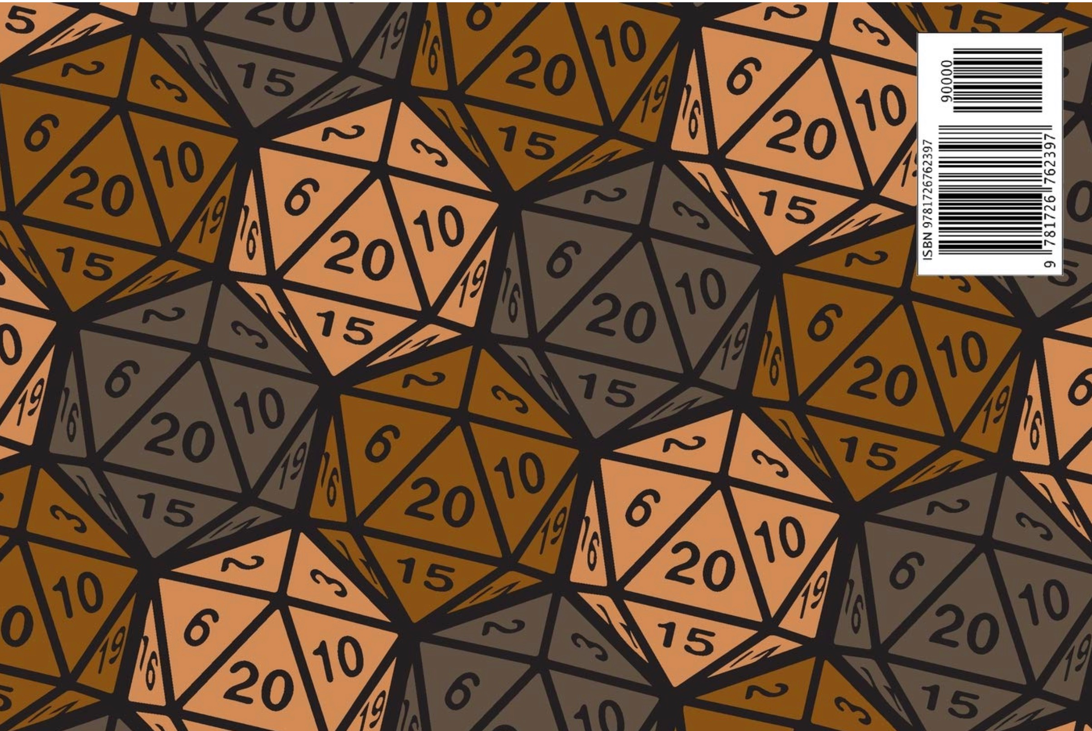
Role Playing Games
RPGs are open-ended games in which the players assume the roles of characters in a story and can have them attempt any action they want. The game is controlled by a game master, who uses tables, dice, and personal judgment to decide on the effect of a character’s efforts.
The players say what their characters do within the simulated world of the game. Dice are rolled to help determine the outcome of combat and other encounters. Over the course of many adventures, the members of a party advance in level and become more powerful-and the game master devises new challenges for them.
Notes:
Dice, are frequently used in a typical game. The twenty-sided die and other dice of unusual shape have become iconic. Dice are used to introduce unpredictability; based on the roll of a die, events may transpire that were not anticipated, foiling even the dungeon master’s plans.

Slide 3
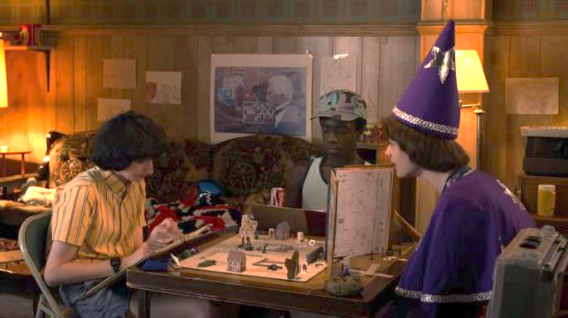
Notes:
The game play in RPGs happens through players and the game master describing their characters' actions through speech. The success of the actions depend on dice rolls and on the set of rules laid out in the RPG system. For a given play session, there is an underlying state of the world that the characters find themselves in. The state of the world includes details about the characters, the monsters and other non-player characters controlled by the game master, and other important information about items, locations and combat. The state of the world is tracked by the players and the game master, often with the aid of paper or app-based character sheets, and software tools like Roll20 or other apps.

Slide 4
Notes:
RPG Systems
There are many roleplaying game systems, each of which have their own set of rules. Most RPG systems involve game play between players and a game master (GM) or dungeon master (DM). They usually have randomized outcomes that are based on dice rolls. Some of the most popular RPG systems are:
Dungeons & Dragons (D&D) is a tabletop role-playing game with a fantasy theme that was originally created in the mid-1970s. It is now in its 5th edition (5e). The rulebooks for D&D include a 300 page Player’s Handbook, a 300 page Dungeon Master’s Guide, and a 350 page Monster Manual, though most of the important aspects of gameplay are given in a 96 page Starter Set. D&D is owned by Wizards of the Coast LLC.

Slide 5
Dungeon World is based on a system called “Powered by the Apocalypse” that uses two 6 sided dice to determine the outcome. There are 3 outcomes:
success (a roll of 10+),
mixed success (a roll of 7-9), and
failure (a roll of 6 or less).
Notes:
Dungeon World is a fantasy RPG created by Sage LaTorra and Adam Koebel, and released under the Creative Commons Attribution 3.0 Unported License. The setting for Dungeon World is D&D-style fantasy setting. The game uses a different rule set than D&D which was adapted by a game called Apocalypse World, and which uses simpler rules and fewer dice rolls. Games based on Apocalypse World rules are called Powered by the Apocalypse games.

Slide 6
Notes:
Cast A Spell (INT) When you release a spell you’ve prepared,
roll+INT.
On a 10+ the the spell is successfully cast and you may cast the spell again later.
On a 7-9 the spell is cast, but choose one:
You draw unwelcome attention or put yourself in a spot. The GM will tell you how.
The spell disturbs the fabric of reality as it is cast; take -1 ongoing to cast a spell until the next time you Prepare Spells.
After it is cast, the spell is forgotten. You cannot cast the spell again until you prepare spells.
Note that maintaining spells with ongoing effects will sometimes cause a penalty to your roll to cast a spell.

Slide 7
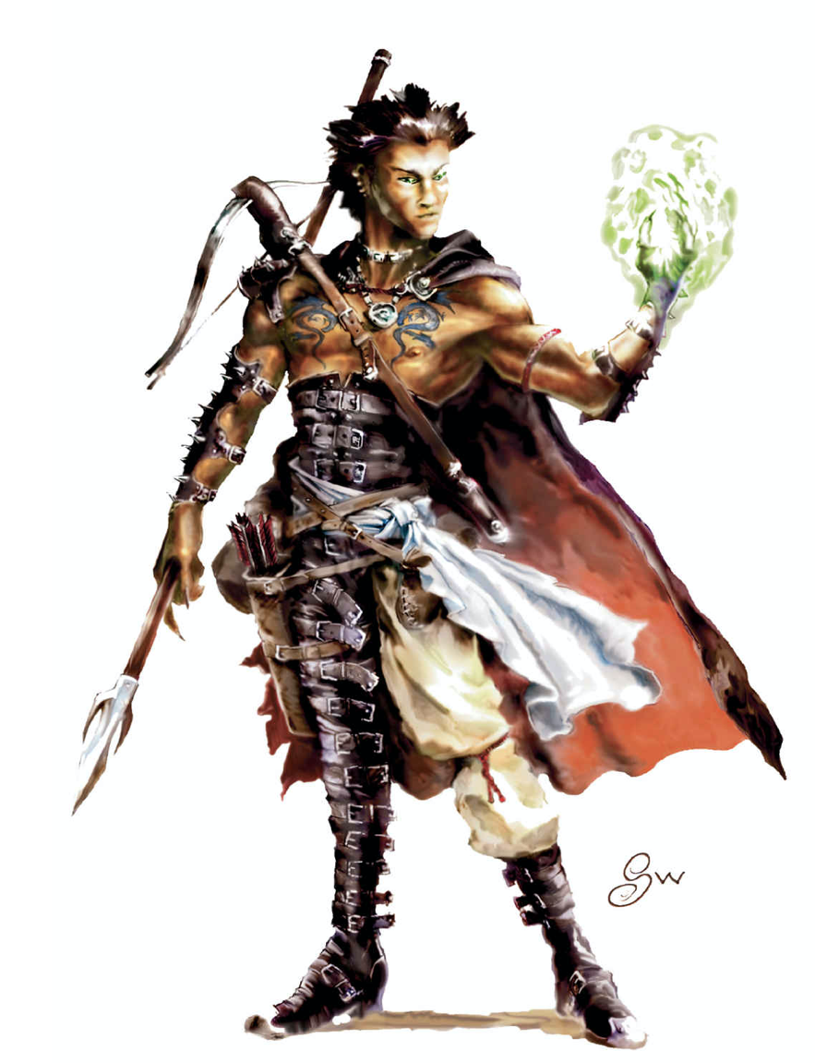
Notes:
Characters
Players create characters who they role play during the game. Characters typically have a class (like fighter, ranger, thief), a level (which describes what level of mastery they have achieved in their class, and which increases over multiple play sessions), a race (like dwarf, elf, human), an alignment (good, neutral, or evil/chaotic), and a set of ability scores (strength, dexterity, constitution, intelligence, wisdom and charisma). Players use a character sheet to track their character’s state. The important stateful information includes things like hit points (a health meter), what items the character currently has in their inventory, how much gold they have collected, and properties of the character (ability scores, which can sometimes be temporarily penalized).

Slide 8
NPCs
Items
Combat
The game master role plays a set of non-player characters (NPCs). These can be anything from monsters to other people who. NPCs also have a representation of their state that includes things like hit points, inventory, and abilities. Many games include a rulebook called a “monster manual” that details different statistics for different kinds of monsters.
Items like weapons, armor, potions, and magic items are important to the game play in most RPGs. They confer special actions or ability modifiers. Locations have properties like what sorts of NPCs the players are likely to encounter. Many games include separate adventure books that describe new locations, new monsters, and new magic items, along with quests that can happen in those locations
There are many rules governing combat, including things like turn order , what kinds of moves can be used in different circumstances, what constitutes a successful attack, when an opponent is defeated, and what happens to a character that is rendered unconscious or killed. Important state features include the hit points and physical distances between players and enemies, etc.

Slide 9
RPGs and NLU
Role Playing Games (RPGs) are an interesting challenge for natural language understanding (NLU) because they have a significant spoken component. Imagine that we have a recording of people playing an RPG. Could we build a model to answer questions like this?
What game is being played? (a classification task)
What move is each player trying to make? (a classification task)
What move will a player likely make next on their next turn? (a prediction task)
How many points does each player have? (a state tracking task)
What things could the player say to describe their move? (a generation task)

Slide 10
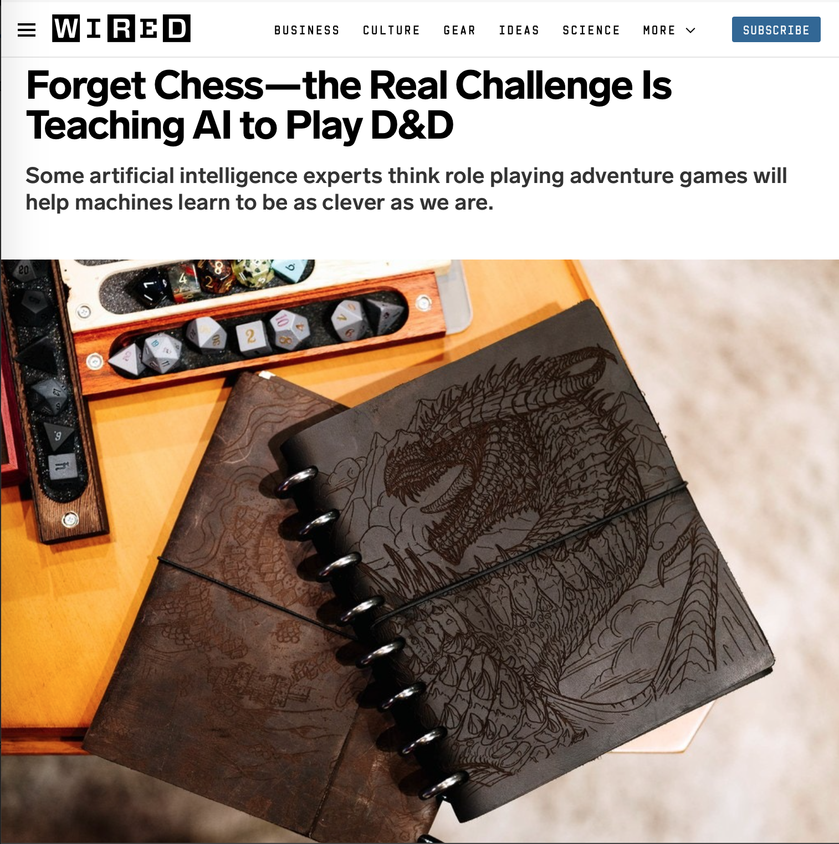
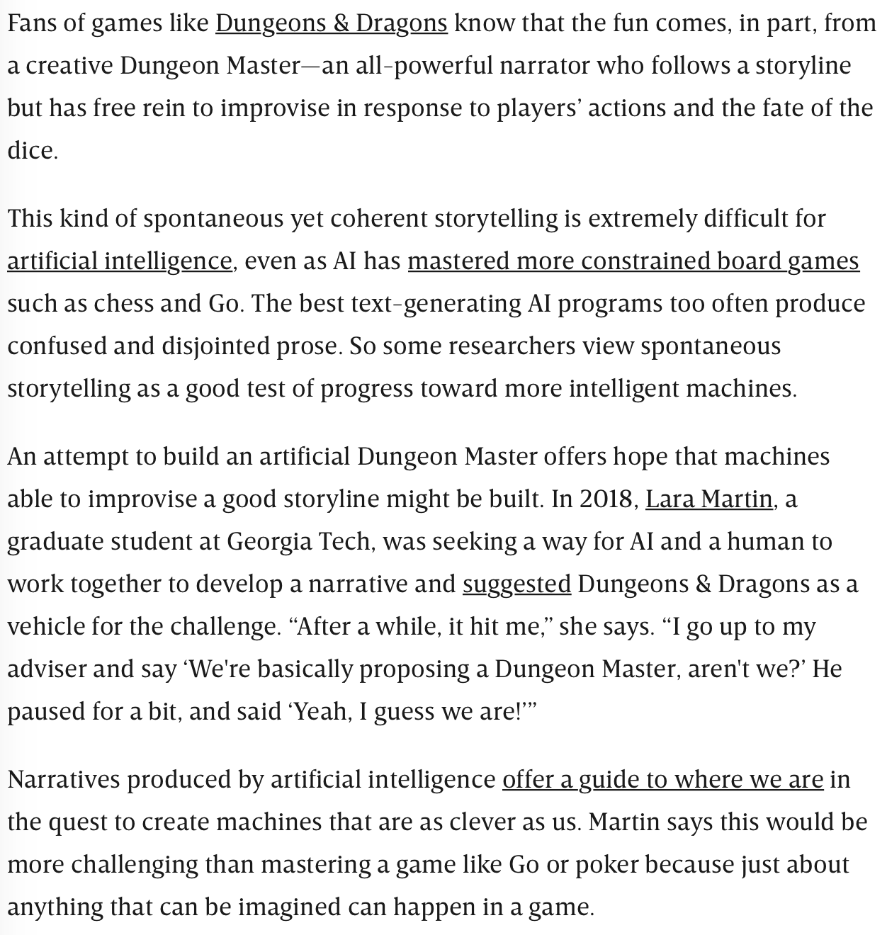
Notes:
https://www.wired.com/story/forget-chess-real-challenge-teaching-ai-play-dandd/

